Slide 1
Applet program using Parameter
import java.applet.Applet;
import java.awt.*;
public class parameter extends Applet
{
public void paint(Graphics g)
{
String str=getParameter("msg");
g.drawString(str,50, 50);
int value = Integer.parseInt(getParameter("value"));
System.out.println(value);
if (value == 10)
{
setBackground(Color.pink);
}
}
}
/*
<applet code="parameter.class" width="300" height="300">
<param name="msg" value="Welcome to applet">
<param name = "value" value = 10>
</applet> */

Slide 2
Java AWT(Abstract Window Toolkit)

Slide 3
Introduction
Java AWT (Abstract Windowing Toolkit) is an API to develop GUI or window-based application in java.
Java AWT components are platform-dependent i.e. components are displayed according to the view of operating system. AWT is heavyweight i.e. its components uses the resources of system.
The java.awt package provides classes for AWT API such as TextField, Label, TextArea, RadioButton, CheckBox, Choice, List etc.

Slide 4
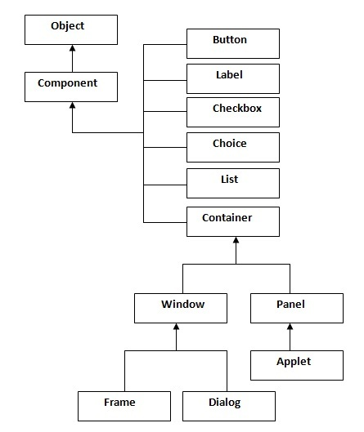
Java AWT Hierarchy

Slide 5
Container
The Container is a component in AWT that can contain another components like buttons, textfields, labels etc. The classes that extends Container class are known as container such as Frame, Dialog and Panel.
Window
The window is the container that have no borders and menu bars. You must use frame, dialog or another window for creating a window.

Slide 6
Panel
The Panel is the container that doesn't contain title bar and menu bars. It can have other components like button, textfield etc.
Frame
The Frame is the container that contain title bar and can have menu bars. It can have other components like button, textfield etc.

Slide 7
AWT Controls
The java.awt package provides classes for AWT API such as Button, TextField, Label, TextArea, RadioButton, CheckBox, Choice, List etc.

Slide 8
AWT Controls& Description
Label
A Label object is a component for placing text in a container.
Button
This class creates a labelled button.
Check Box
A check box is a graphical component that can be in either an on (true) or off (false) state.
Check Box Group
The CheckboxGroup class is used to group the set of checkbox.
List
The List component presents the user with a scrolling list of text items.
Text Field
A TextField object is a text component that allows for the editing of a single line of text.

Slide 9
Text Area
A TextArea object is a text component that allows for the editing of a multiple lines of text.
Choice
A Choice control is used to show pop up menu of choices. Selected choice is shown on the top of the menu.
Canvas
A Canvas control represents a rectangular area where application can draw something or can receive inputs created by user.
Image
An Image control is superclass for all image classes representing graphical images.
Scroll Bar
A Scrollbar control represents a scroll bar component in order to enable user to select from range of values.
Dialog
A Dialog control represents a top-level window with a title and a border used to take some form of input from the user.
File Dialog
A FileDialog control represents a dialog window from which the user can select a file.

Slide 10
Java.awt.Label
Class declaration
Following is the declaration for java.awt.Label class:
public class Label extends Component implements Accessible
Field (location of the label in the component Frame)
Following are the fields for java.awt.Component class:
static int CENTER -- Indicates that the label should be centered.
static int LEFT -- Indicates that the label should be left justified.
static int RIGHT -- Indicates that the label should be right justified.

Slide 11
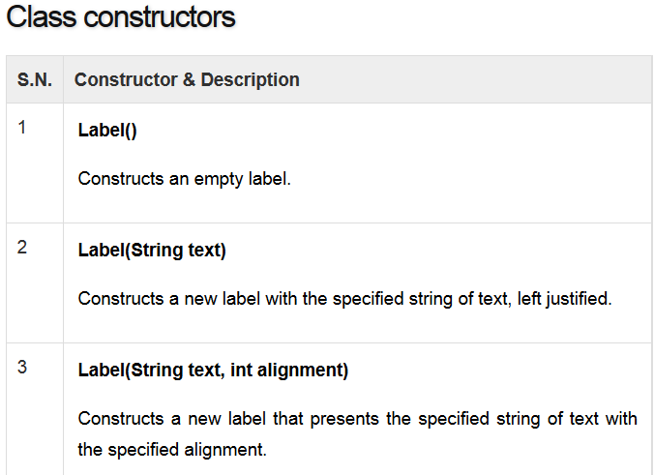

Slide 12
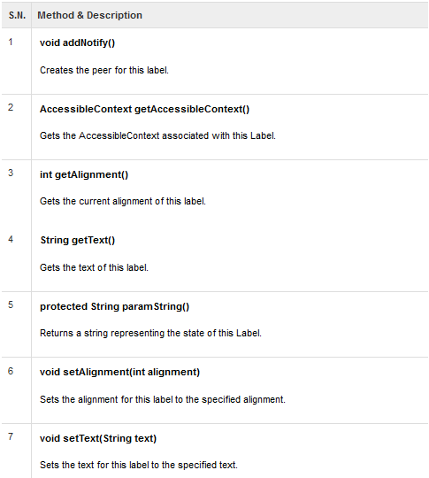

Slide 13
Button class Constructor
Button()
- Constructs an empty labeled button
Button(String text)
Button with the specified name exists in the component

Slide 14
Methods of Button()
addActionListener (ActionListener) Adds the specified action listener to receive action events from this button.
addNotify() Creates the peer of the button.
getActionCommand() Returns the command name of the action event fired by this button.
getLabel () Gets the label of this button.
paramString () Returns the parameter string representing the state of this button.
processActionEvent (ActionEvent) Processes action events occurring on this button by dispatching them to any registered ActionListener objects.
processEvent (AWTEvent) Processes events on this button.
removeActionListener (ActionListener) Removes the specified action listener so that it no longer receives action events from this button.
setActionCommand (String) Sets the command name for the action event fired by this button.
setLabel(String) Sets the button's label to be the specified string.

Slide 15
Component class
A component is an object having a graphical representation that can be displayed on the screen and that can interact with the user. Examples of components are the buttons, checkboxes, and scrollbars of a typical graphical user interface.
The Component class is the abstract superclass of the nonmenu-related Abstract Window Toolkit components.

Slide 16
Useful Methods of Component class
Method | Description
public void add(Component c) | inserts a component on this component.
public void setSize(int width,int height) | sets the size (width and height) of the component.
public void setLayout(LayoutManager m) | defines the layout manager for the component.
public void setVisible(boolean status) | changes the visibility of the component, by default false.

Slide 17
Requirement for Java AWT programs
To create simple AWT example, you need a frame. There are two ways to create a frame in AWT.
By extending Frame class (inheritance)
By creating the object of Frame class (association)

Slide 18
Event and Listener (Java Event Handling)
Changing the state of an object is known as an event.
For example, click on button, dragging mouse etc. The java.awt.event package provides many event classes and Listener interfaces for event handling.

Slide 19
Event Classes | Listener Interfaces
ActionEvent | ActionListener
MouseEvent | MouseListener and MouseMotionListener
MouseWheelEvent | MouseWheelListener
KeyEvent | KeyListener
ItemEvent | ItemListener
TextEvent | TextListener
AdjustmentEvent | AdjustmentListener
WindowEvent | WindowListener
ComponentEvent | ComponentListener
ContainerEvent | ContainerListener
FocusEvent | FocusListener

Slide 20
Steps to perform Event Handling
Following steps are required to perform event handling:
Implement the Listener interface and overrides its methods
Register the component with the Listener

Slide 21
Button
public void addActionListener(ActionListener a){}
MenuItem
public void addActionListener(ActionListener a){}
TextField
public void addActionListener(ActionListener a){}
public void addTextListener(TextListener a){}
TextArea
public void addTextListener(TextListener a){}
Checkbox
public void addItemListener(ItemListener a){}
Choice
public void addItemListener(ItemListener a){}
List
public void addActionListener(ActionListener a){}
public void addItemListener(ItemListener a){}

Slide 22
Event handling
Sample program using ActionListener for the Button control
Refer to the program Button2.java

Slide 23
import java.awt.*;
import java.awt.event.*;
public class Button2 implements ActionListener
{
Button b1,b2;
Frame f;
TextField t1;
Button2()
{
f=new Frame("ActionListener Example");
t1=new TextField();
t1.setBounds(50,50,150,20);
b1=new Button("Click Here");
b2= new Button("Exit");
b1.setBounds(50,100,60,30);
b2.setBounds(50,300,60,30);
f.add(b1);
f.add(b2);
f.add(t1);
f.setSize(400,400);
b1.addActionListener(this);
b2.addActionListener(this);
f.setLayout(null);
f.setVisible(true);
}// constructor
public void actionPerformed(ActionEvent e)
{
if (e.getSource()==b1)
{
System.out.println("sucess");
t1.setText("Welcome .....");
}
else if (e.getSource()==b2)
System.exit(0);
}
public static void main(String[] args)
{
new Button2();
}
}

Slide 24
The LayoutManagers are used to arrange components in a particular manner. LayoutManager is an interface that is implemented by all the classes of layout managers. There are following classes that represents the layout managers:
java.awt.BorderLayout
java.awt.FlowLayout
java.awt.GridLayout
java.awt.CardLayout
java.awt.GridBagLayout
javax.swing.BoxLayout
javax.swing.GroupLayout
javax.swing.ScrollPaneLayout
javax.swing.SpringLayout etc.

Slide 25
BorderLayout:
The BorderLayout is used to arrange the components in five regions: north, south, east, west and center. Each region (area) may contain one component only. It is the default layout of frame or window. The BorderLayout provides five constants for each region:
public static final int NORTH
public static final int SOUTH
public static final int EAST
public static final int WEST
public static final int CENTER
Constructors of BorderLayout class:
BorderLayout(): creates a border layout but with no gaps between the components.
JBorderLayout(int hgap, int vgap): creates a border layout with the given horizontal and vertical gaps between the components.

Slide 26
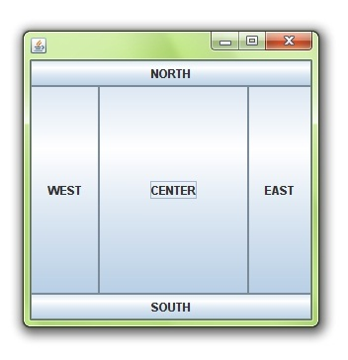
Border Layout - Structure

Slide 27
Grid Layout
The GridLayout is used to arrange the components in rectangular grid. One component is displayed in each rectangle.
Constructors of GridLayout class:
GridLayout(): creates a grid layout with one column per component in a row.
GridLayout(int rows, int columns): creates a grid layout with the given rows and columns but no gaps between the components.
GridLayout(int rows, int columns, int hgap, int vgap): creates a grid layout with the given rows and columns along with given horizontal and vertical gaps.

Slide 28
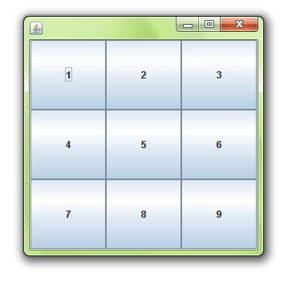

Slide 29
Flow Layout
The FlowLayout is used to arrange the components in a line, one after another (in a flow). It is the default layout of applet or panel.
Fields of FlowLayout class:
public static final int LEFT
public static final int RIGHT
public static final int CENTER
public static final int LEADING
public static final int TRAILING
Constructors of FlowLayout class:
FlowLayout(): creates a flow layout with centered alignment and a default 5 unit horizontal and vertical gap.
FlowLayout(int align): creates a flow layout with the given alignment and a default 5 unit horizontal and vertical gap.
FlowLayout(int align, int hgap, int vgap): creates a flow layout with the given alignment and the given horizontal and vertical gap.

Slide 30
Event handling using Choice and List
Refer the program choice.java

Slide 31
import java.awt.*;
import java.awt.event.*;
import java.applet.*;
/* <applet code ="choice.class" width="300" height="200"> </applet> */
public class choice extends Applet implements ItemListener
{
List ls;
Choice choice;
Label lb1,lb2,lb3;
TextField t;
Button b1;
public void init()
{
setLayout(new BorderLayout());
Panel p1= new Panel();
Panel p2= new Panel();
p1.setLayout(new GridLayout(2,2));
p2.setLayout(new GridLayout(1,1));
lb1=new Label("Select an Option");
p1.add(lb1);
choice =new Choice();
choice.addItem("Snacks");
choice.addItem("Drinks");
choice.addItemListener(this);
p1.add(choice);
lb2=new Label("What you want to have");
p1.add(lb2);
ls=new List(4,true);
p1.add(ls);
ls.add("Pastry...8");
ls.add("French Fries...20");
ls.add("Burger...15");
ls.add("Dosa...20");
ls.addItemListener(this);
lb3=new Label("Your Bill is");
p2.add(lb3);
t=new TextField(20);
p2.add(t);
add(p1,BorderLayout.NORTH);
add(p2,BorderLayout.SOUTH);
}
public void itemStateChanged(ItemEvent e)
{
int amt,i;
String st[]= new String[4];
amt=0;
if(e.getSource()==choice)
{
if(choice.getSelectedItem()=="Snacks")
{
ls.removeAll();
ls.add("Pastry...8");
ls.add("French Fries...20");
ls.add("Burger...15");
ls.add("Dosa...20");
}
else
{
ls.removeAll();
ls.add("Coffee...12");
ls.add("Cola...12");
ls.add("Tea...5");
ls.add("Juice...15");
}
}
else
{
st=ls.getSelectedItems();
for(i=0;i<st.length;i++)
{
if(st[i].equals("Pastry..8"));
{
amt=amt+8;
}
if(st[i].equals("French Fries..20"));
{
amt=amt+20;
}
if(st[i].equals("Burger..15"));
{
amt=amt+15;
}
if(st[i].equals("Dosa..20"));
{
amt=amt+20;
}
if(st[i].equals("Coffee..12"));
{
amt=amt+12;
}
if(st[i].equals("Cola..12"));
{
amt=amt+12;
}
if(st[i].equals("Tea..5"));
{
amt=amt+5;
}
if(st[i].equals("Juice..15"));
{
amt=amt+15;
}
} t.setText(String.valueOf(amt));
}
}
}

Slide 32
Delegation Event model
Event Handling is the mechanism that controls the event and decides what should happen if an event occurs.
This mechanism have the code which is known as event handler that is executed when an event occurs. Java Uses the Delegation Event Model to handle the events. This model defines the standard mechanism to generate and handle the events. Let's have a brief introduction to this model.
The Delegation Event Model has the following key participants namely:
Source - The source is an object on which event occurs. Source is responsible for providing information of the occurred event to it's handler. Java provide as with classes for source object.
Listener - It is also known as event handler.Listener is responsible for generating response to an event. From java implementation point of view the listener is also an object. Listener waits until it receives an event. Once the event is received , the listener process the event an then returns.

Slide 33
Java Event Delegation Model
Sources, Events, and Listeners
In the Java Event Delegation Model the publisher (source) notifies registered subscribers (listeners) when certain events occur.

Slide 34
There are many types of events and listeners in Java:

Slide 35
Adapter classes
Adapters are abstract classes for receiving various events. The methods in these classes are empty. These classes exists as convenience for creating listener objects.

Slide 36
AWT Adapters:
Following is the list of commonly used adapters while listening GUI events in AWT.
Focus Adapter:
An abstract adapter class for receiving focus events.
Key Adapter:
An Abstract adapter class for receiving key events

Slide 37
MouseAdapter
An abstract adapter class for receiving mouse events.
MouseMotionAdapter
An abstract adapter class for receiving mouse motion events.
WindowAdapter
An abstract adapter class for receiving window events.

Slide 38
Mouse Adapter
Class declaration
java.awt.event.MouseAdapter
public abstract class MouseAdapter extends Object
implements MouseListener, MouseWheelListener, MouseMotionListener

Slide 39
Methods
void mouseClicked(MouseEvent e)
Invoked when the mouse button has been clicked (pressed and released) on a component.
void mouseDragged(MouseEvent e)
Invoked when a mouse button is pressed on a component and then dragged.

Slide 40
3 void mouseEntered(MouseEvent e) | Invoked when the mouse enters a component.
4 void mouseExited(MouseEvent e) | Invoked when the mouse exits a component.
5 void mouseMoved(MouseEvent e) | Invoked when the mouse cursor has been moved onto a component but no buttons have been pushed.
6 void mousePressed(MouseEvent e) | Invoked when a mouse button has been pressed on a component.
7 void mouseReleased(MouseEvent e) | Invoked when a mouse button has been released on a component.
8 void mouseWheelMoved(MouseWheelEvent e) | Invoked when the mouse wheel is rotated.

Slide 41
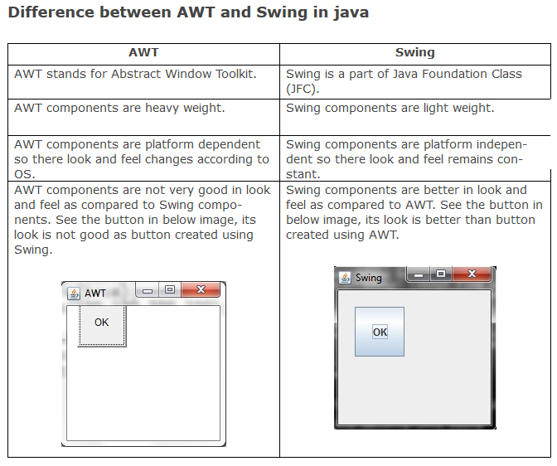

Slide 42

Refer more on Various Adapter classes and Layout Managers also…..
END

